Slide 1
Newtonian Mechanics
By Conor Solner

Slide 2
What is Newtonian Mechanics?
They describe three physical laws between a body and forces acted upon it and its motion response to those forces.
Newtons First Law: In an inertial reference frame, an object either remains at rest or continues to move at a constant velocity unless acted upon by a force
Newtons Second Law: In an inertial reference frame, the vector sum of Forces on an object is equal to the mass of the object multiplied by acceleration a of the object F = ma
When on body exerts a force on a second body, the second body simultaneously exerts a force equal in magnitude and opposite in direction of the first body.

Slide 3
What do we hope to achieve here?
The goal is to apply a mathematical model of hang time by using Newtons Second law of motion
Here we will be applying acceleration as a second derivative of the position function. $a=\left(\frac{d^{2}}{dt^{2}}y\right)$
Then we solve for velocity
Finally solve for hang time
Easy right?

Slide 4
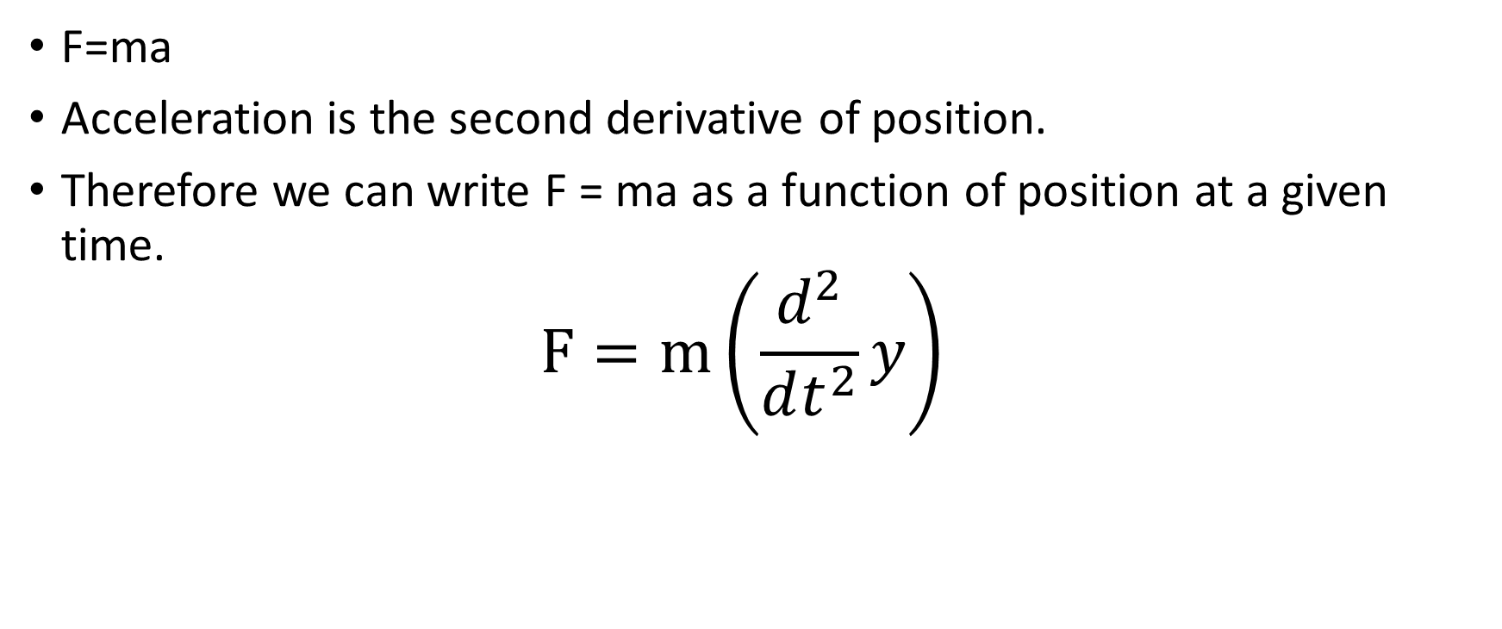
Newtons Second Law
F=ma
Acceleration is the second derivative of position.
Therefore we can write F = ma as a function of position at a given time. $F=m\left(\frac{d^{2}}{dt^{2}}y\right)$

Slide 5
Hang Time Example
We need to make a few assumptions.
The first assumption we will be using gravity in feet so it will be
$$g=32 \frac{ft}{s^{2}}$$
Mass of the player is represented as “m”
The average height of player jumping is 2.5 feet

Slide 6
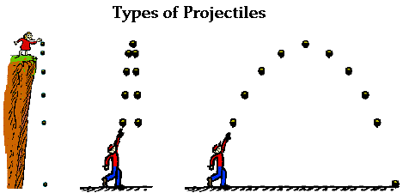
Here is a visual representation of Hang Time

Slide 7
Solving Hang Time
We need to solve the differential equation $F=m(\frac{d^{2}}{dt^{2}}y)$ which we get as $y\left(t\right)=−16t^{2}+tv$ (see sol := y(t) = $−16t^{2}+tv$ line 2)
We solve for the maximum time because the time at its maximum produces a maximum height(which is 2.5 feet)
Now that we have a solved differential equation we solve for velocity of our differential equation which is
$v=12.64911064 feet per second$ *see lines 5 and 6*
Summary: we have a solvable differential equation “y(t)” and an initial velocity of $12.64911064 feet per second$

Slide 8
Now that we have some key components
If we input what we know so far into our differential equation we get
${−16t}^{2}+12.64911064t$ so we can now set this equation equal to maximum height (which would be 2.5 feet) and we can solve for time.
Maximum time for an athlete to jump 2.5 feet into the air would be solved by using the quadradic equation
$t=\frac{−b+\sqrt{b^{2}−4ac}}{2a}$ lines 7 and 8
Maximum time must be positive, negative time would be it would be going backwards so t = 0.3952847075

Slide 9
An alternative method to solving for time
We can take the initial velocity (12.64911064 feet per second) and divide it by gravity (32 feet per seconds squared)
This works because $\frac{\frac{ft}{s}}{\frac{ft}{s^{2}}}$ simplifies to seconds so…
$\frac{initial velocity}{gravitational acceleration}=\frac{\text{12.64911064}}{32}=0.3952847075 seconds$
See line 9

Slide 10
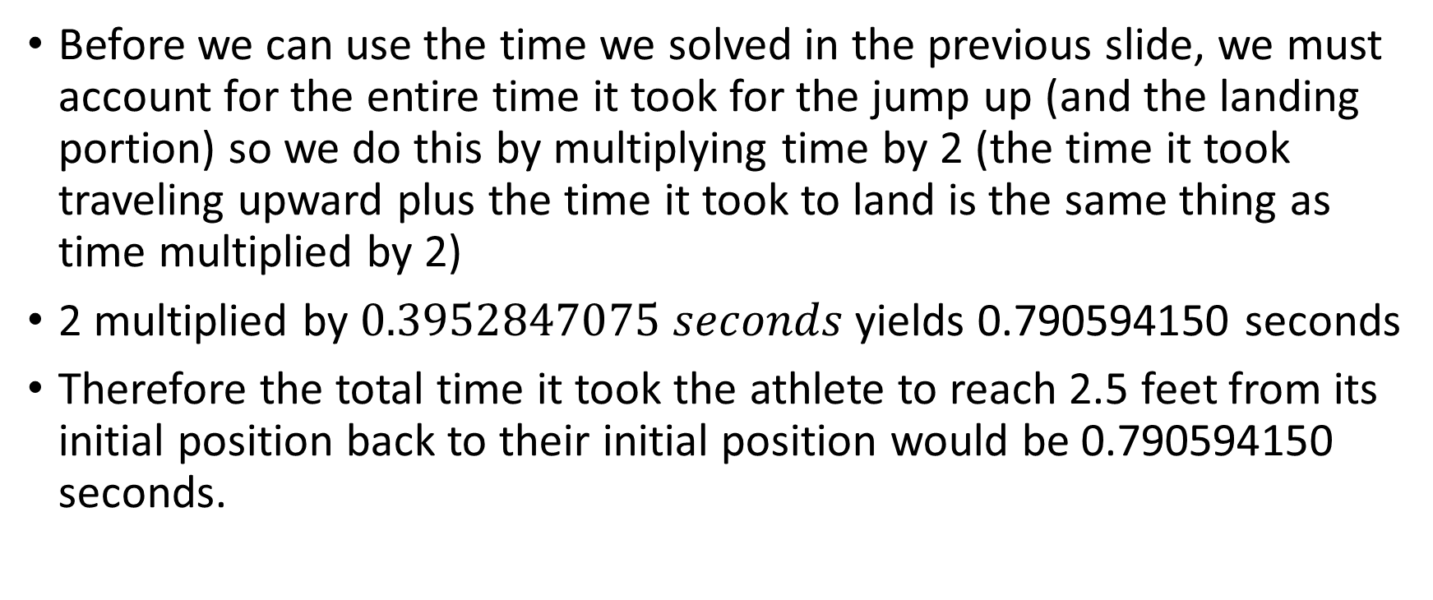
Now that we have the most important piece of the puzzle (time)
Before we can use the time we solved in the previous slide, we must account for the entire time it took for the jump up (and the landing portion) so we do this by multiplying time by 2 (the time it took traveling upward plus the time it took to land is the same thing as time multiplied by 2)
2 multiplied by $0.3952847075 seconds$ yields 0.790594150 seconds
Therefore the total time it took the athlete to reach 2.5 feet from its initial position back to their initial position would be 0.790594150 seconds.

Slide 11
Now we solved our first differential equation for projectile motion
To sum up the work we accomplished, we started with knowing Newtons Second Law of motion F=ma
We then solved the differential equation for initial velocity
Next we applied the quadradic formula to solve for time
Then a surprising twist of applying abstract thinking to solve for entire time of motion.
Finally celebrating the that we did all this work just to solve the total Hang Time of an athlete who has jumped 2.5 feet in the air.

